Slide 1

Insights
Module-2 Week-3

Slide 2
Agenda
Distributed Systems – Introduction
Sharding – Recap and Case Studies
2 Phase Commit Demo
Saga Patterns

Slide 3
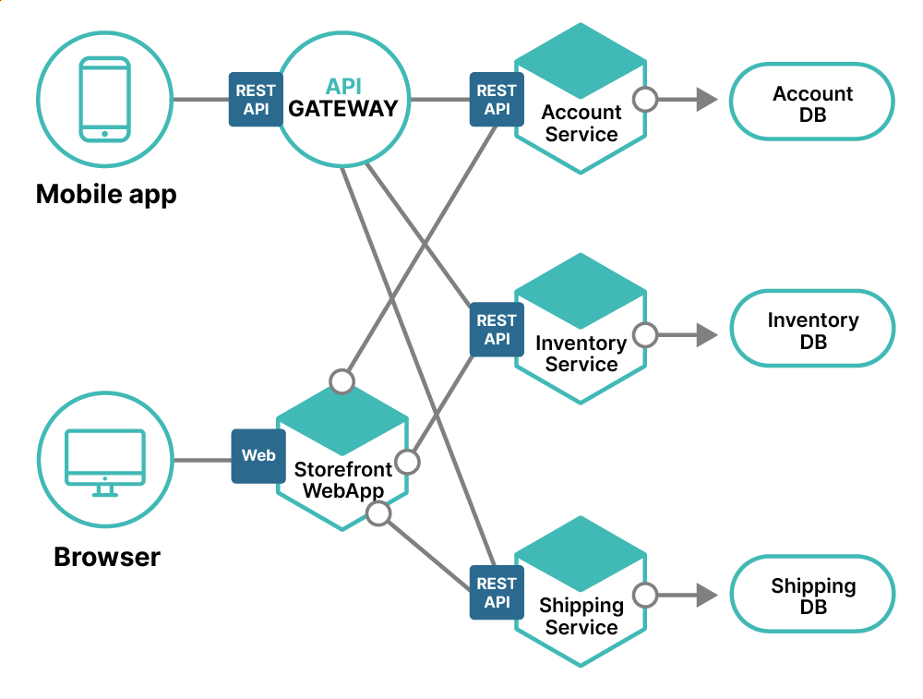

Slide 4
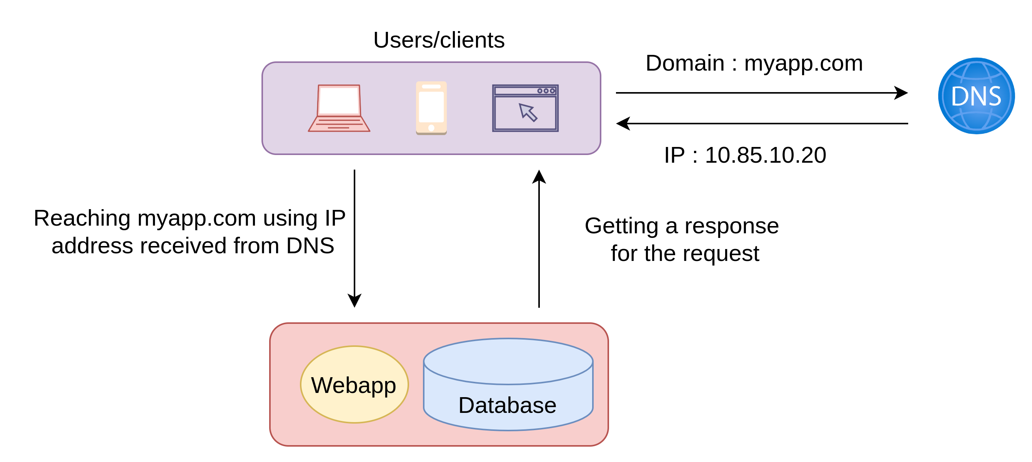

Slide 5
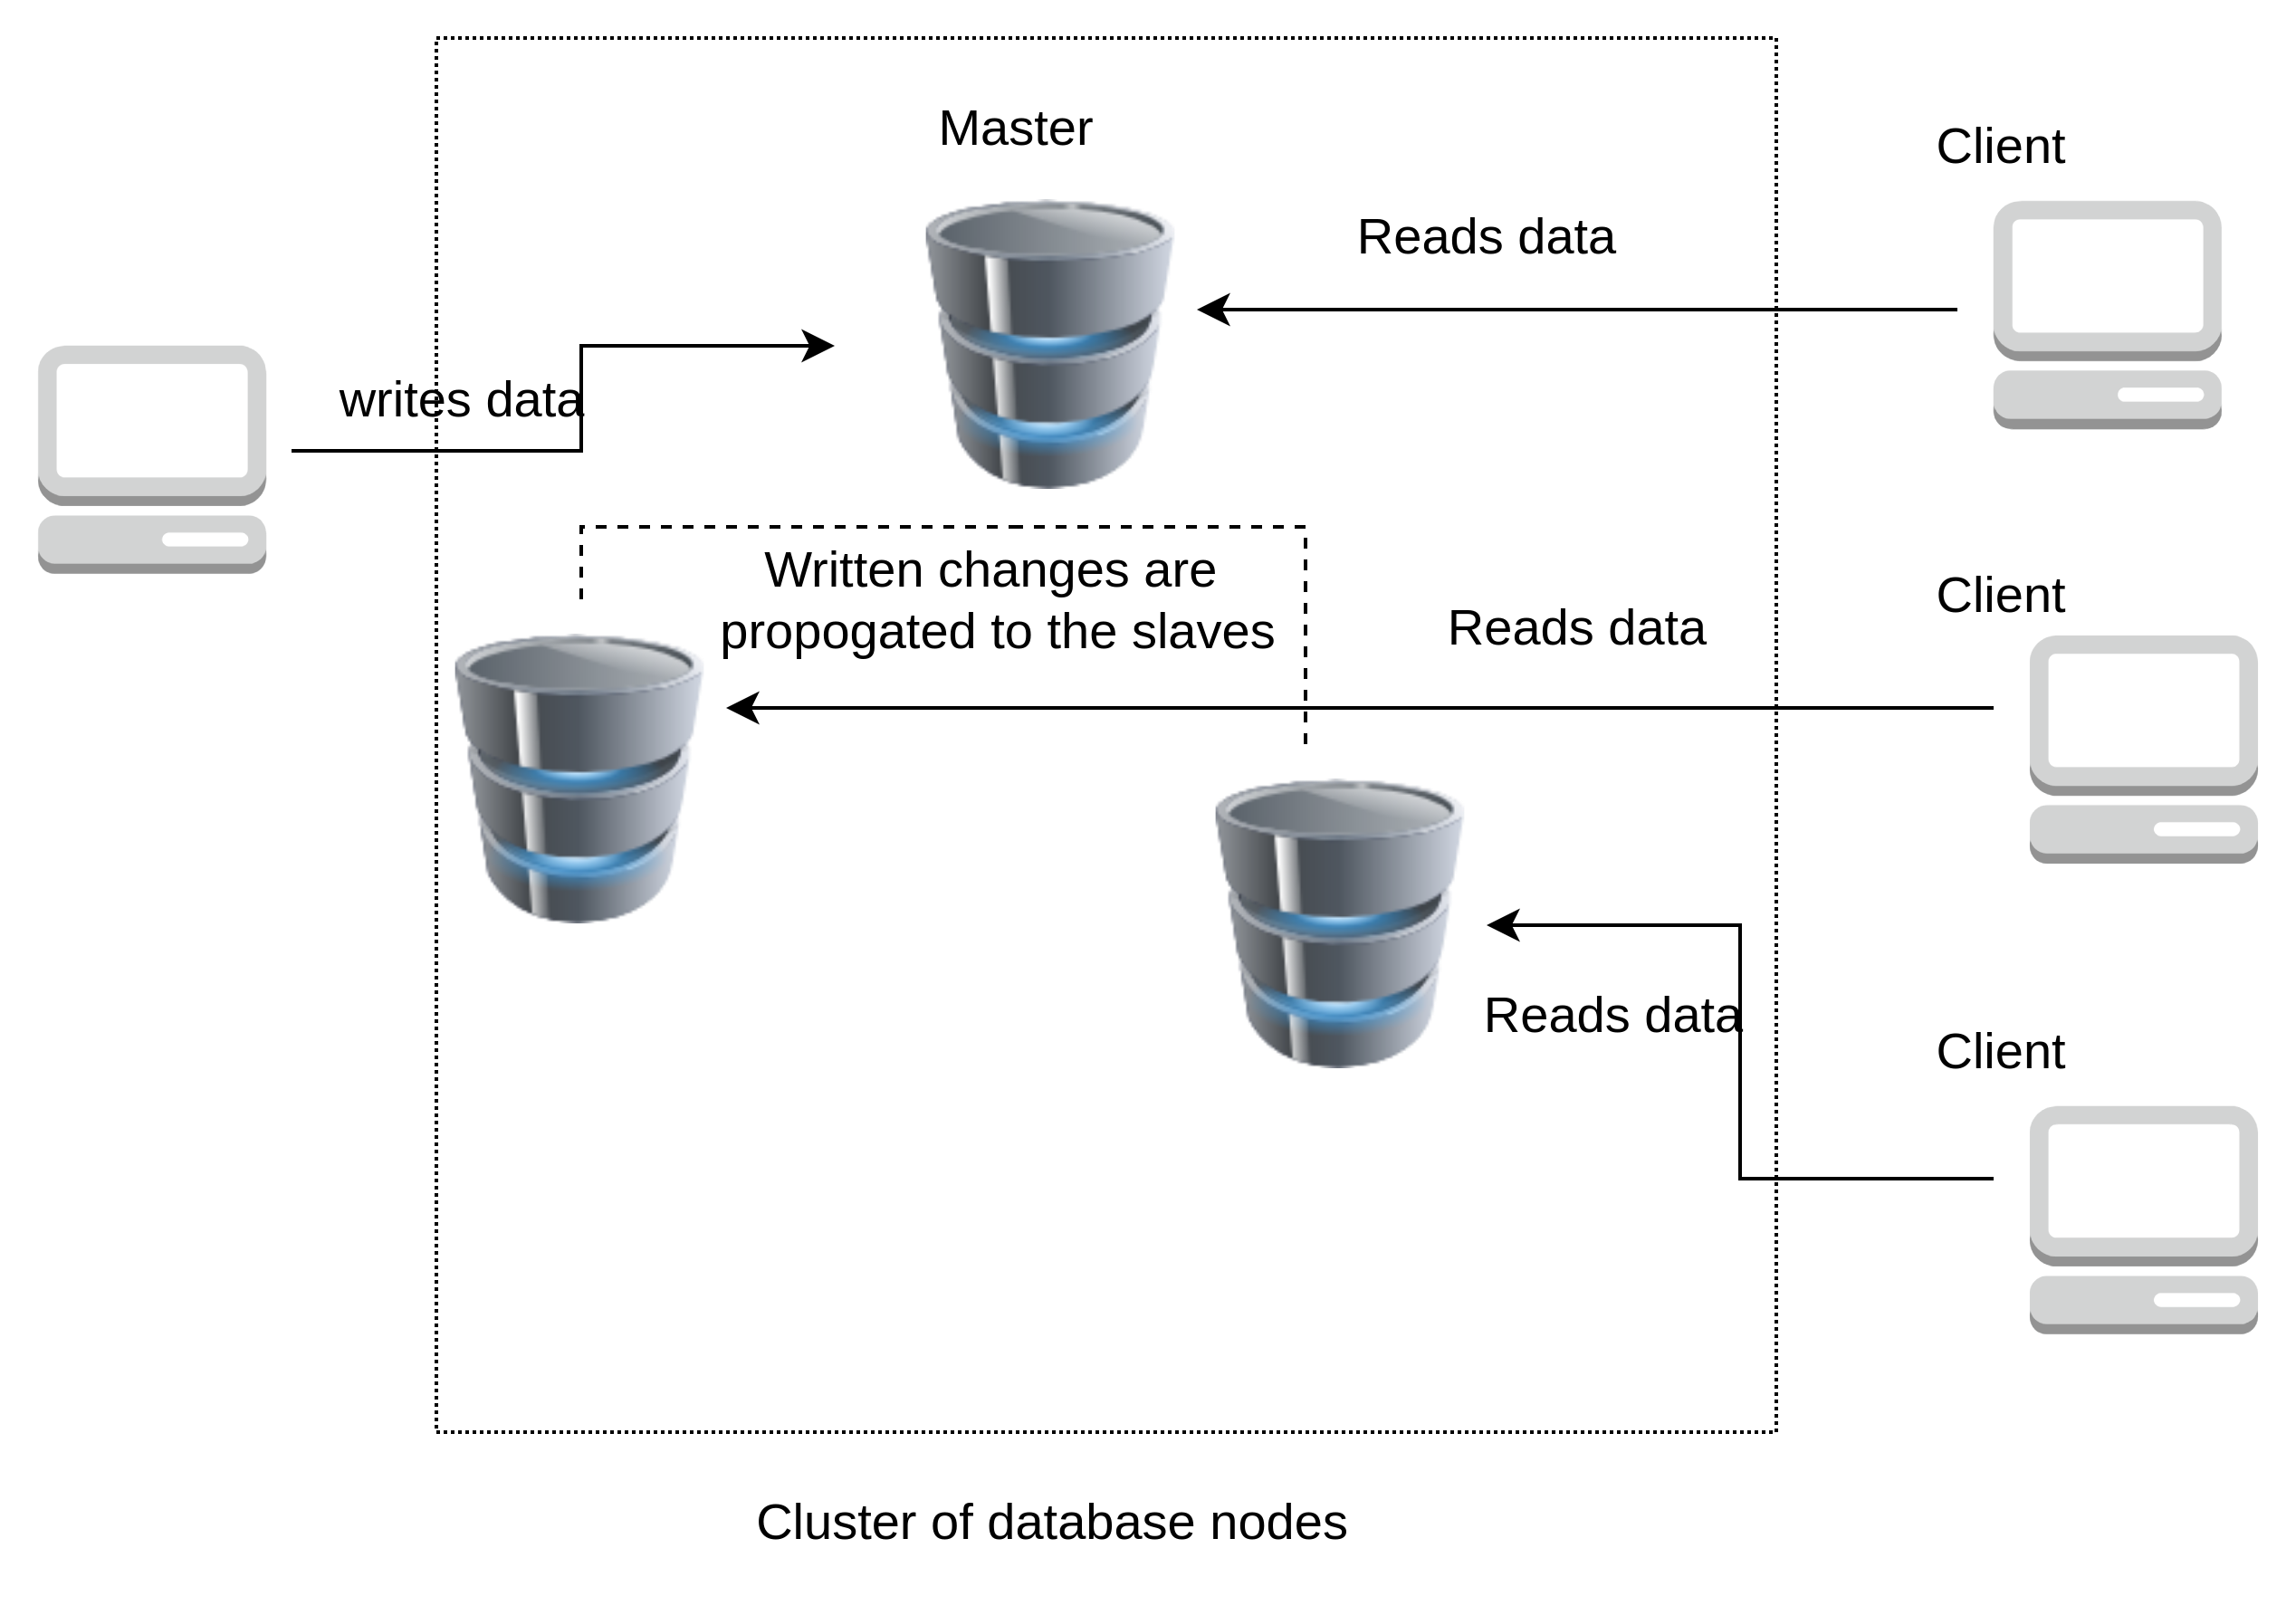
Primary and Secondary (Master Slave)

Slide 6
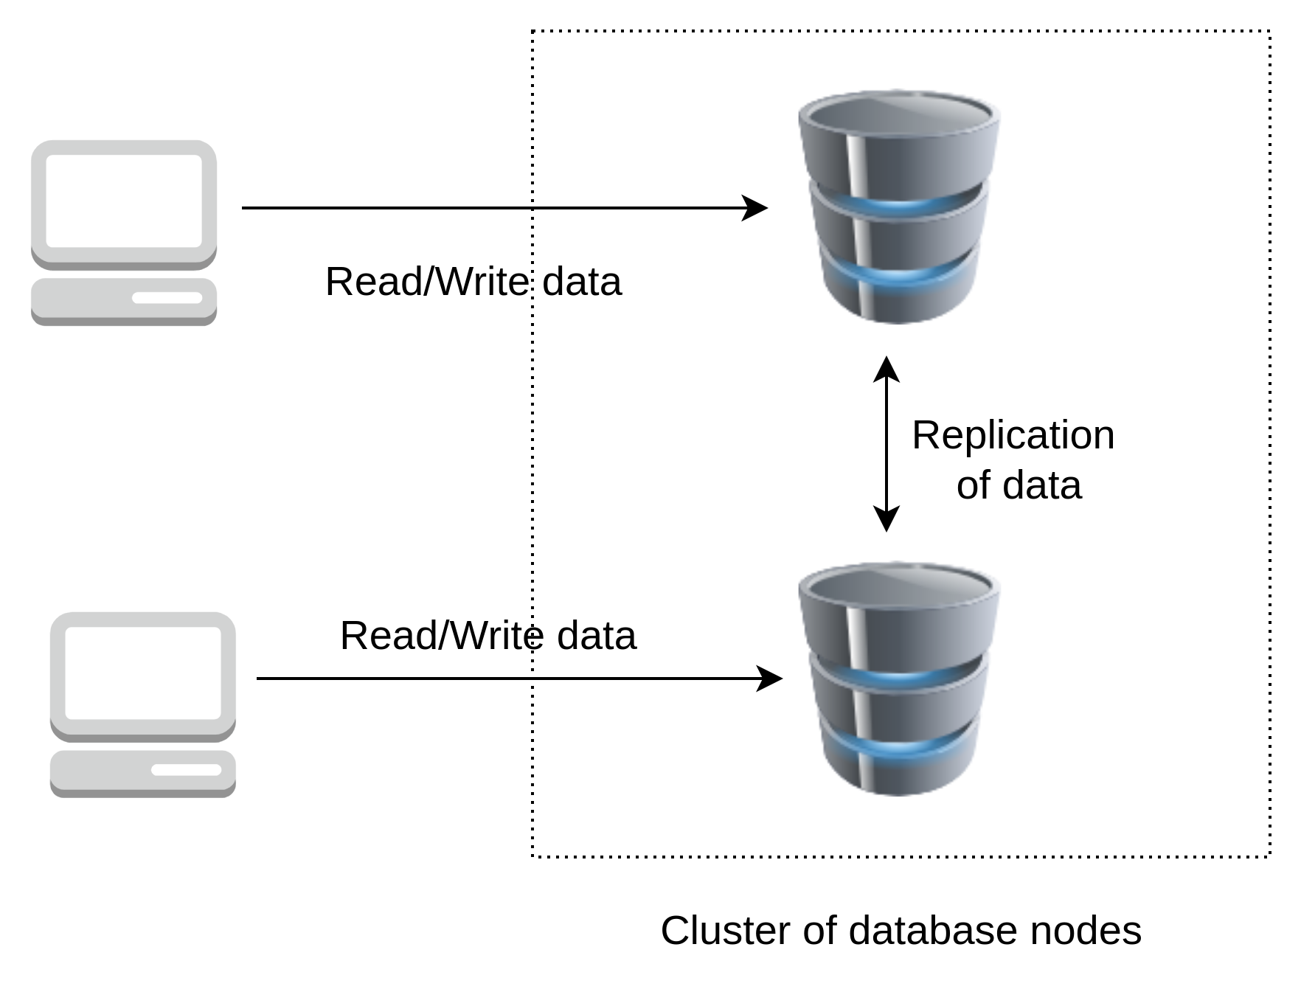
Master Master

Slide 7
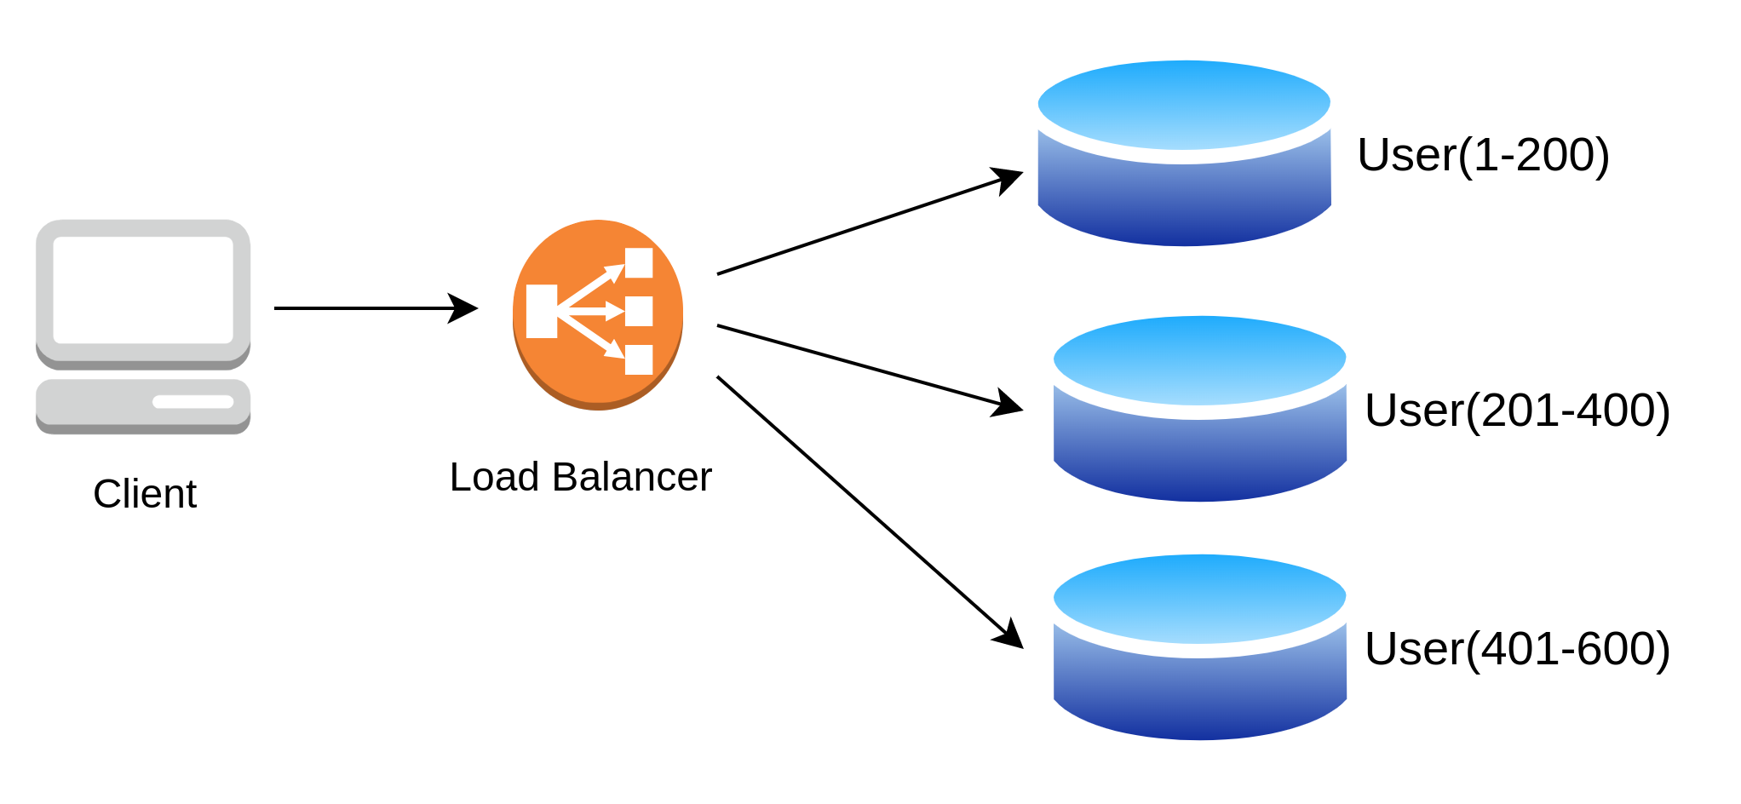
Sharding

Slide 8
Vitess

Slide 9
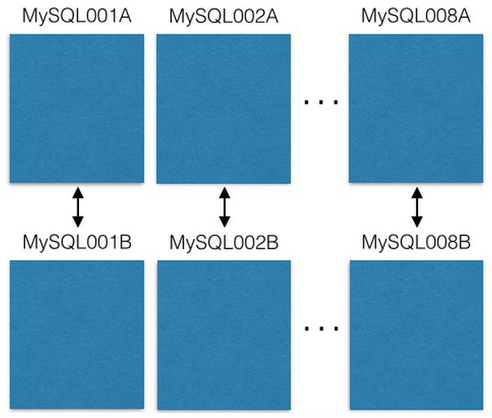
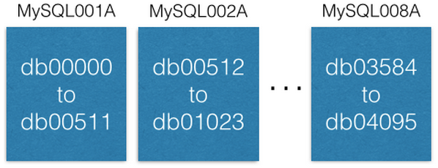
Pin: https://www.pinterest.com/pin/241294492511762325/
Shard ID = (241294492511762325 >> 46) & 0xFFFF = 3429 Type ID = (241294492511762325 >> 36) & 0x3FF = 1 Local ID = (241294492511762325 >> 0) & 0xFFFFFFFFF = 7075733
conn = MySQLdb.connect(host=”MySQL012A”) conn.execute(“SELECT data FROM db03429.pins where local_id=7075733”)

Slide 10
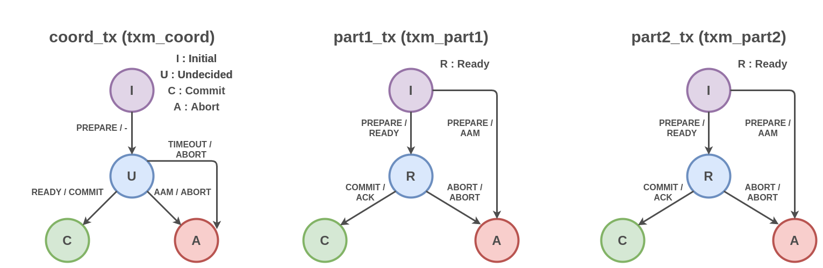
Two Phase Commit – First Phase
Notes:
First Phase – Voting Phase
Second Phase – Decision Phase

Slide 11
Code Walkthrough

Slide 12
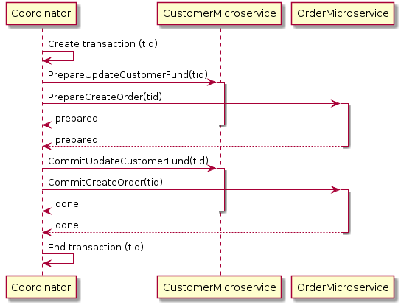
2pc Pattern

Slide 13
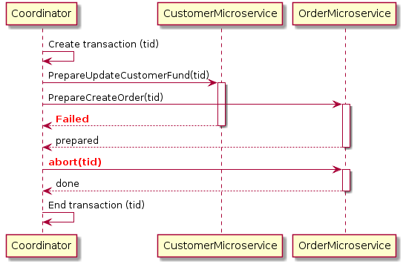
2pc Pattern

Slide 14
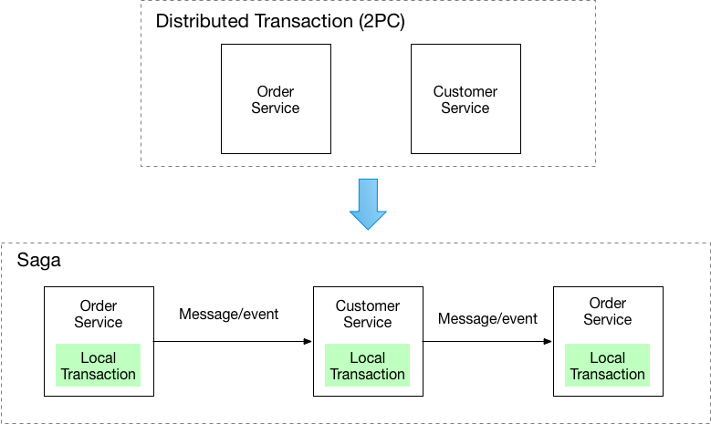
2PC vs Saga

Slide 15
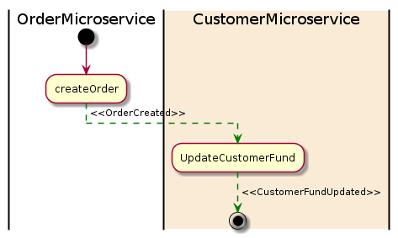
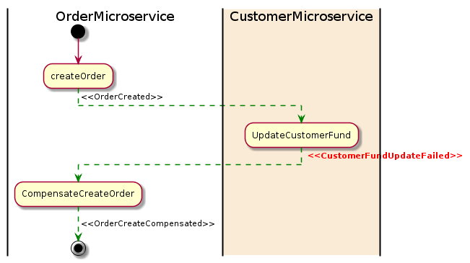
Saga Pattern

Slide 16
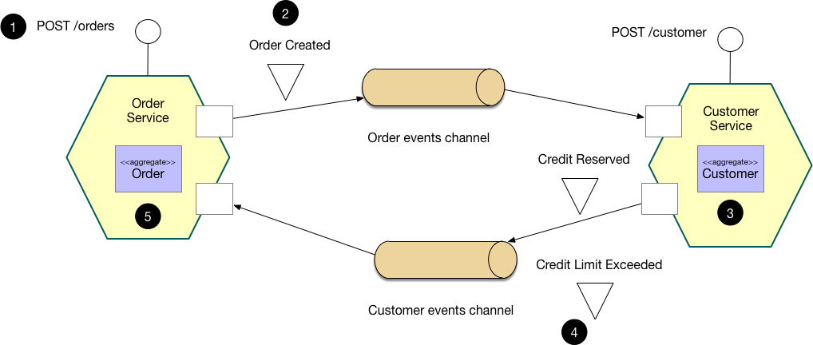
Choreography-based saga

Slide 17
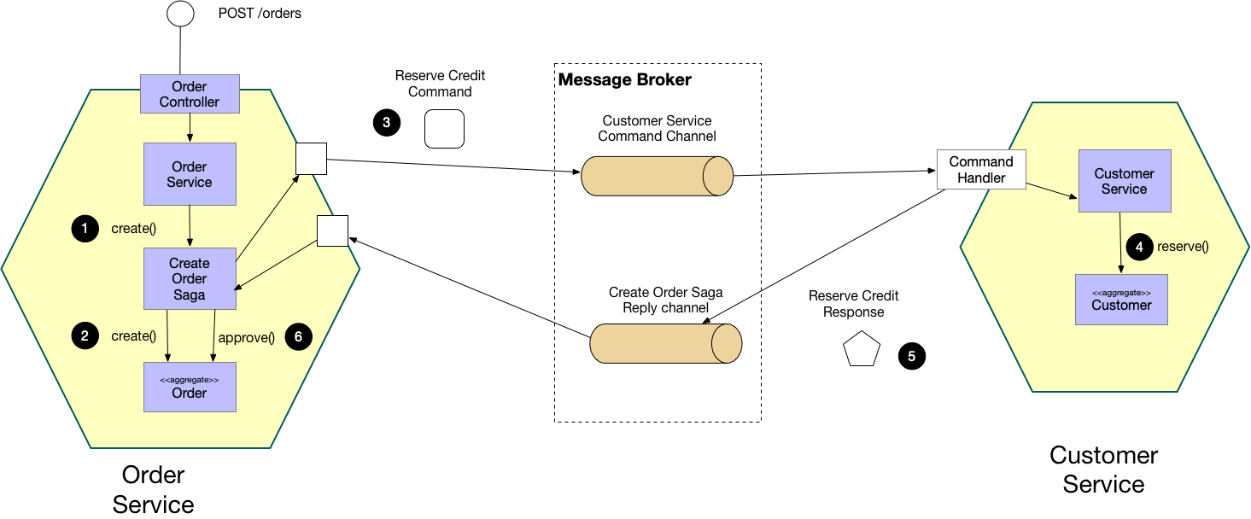
Orchestration-based saga

Slide 18

Research Paper on Saga Implementations

Slide 19
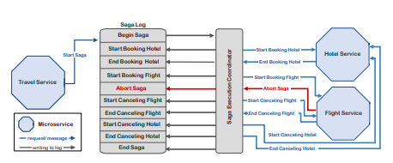

Slide 20
References
https://openproceedings.org/2018/conf/edbt/paper-65.pdf
https://microservices.io/patterns/data/saga.html
http://ceur-ws.org/Vol-2839/paper12.pdf
https://github.com/eventuate-tram/eventuate-tram-core
https://microservices.io/patterns/data/transactional-outbox.html
http://chrisrichardson.net/post/microservices/2019/07/09/developing-sagas-part-1.html
https://static.googleusercontent.com/media/research.google.com/en//archive/chubby-osdi06.pdf
https://bikas-katwal.medium.com/zookeeper-introduction-designing-a-distributed-system-using-zookeeper-and-java-7f1b108e236e
https://github.com/bkatwal/zookeeper-demo
https://raft.github.io/#implementations
http://thesecretlivesofdata.com/raft/
https://github.com/bkatwal/zookeeper-demo#setup-and-usage
https://github.com/Netflix/conductor
https://github.com/absent1706/saga-demo
https://medium.com/pinterest-engineering

